Slide 1
Simple Review
Counting sort
  How if there are 17 elements not greater than x in A?
    Put the last one in position 17, the penultimate one in position 16,…
  If k = O(n), then counting sort takes Θ(n) time.
Radix sort
  Sort on least-significant digit first with auxiliary stable sort.
  Θ(d T(n)), if we use counting sort and d is constant, Θ(n)
Bucket sort
  Divide the interval [0,1) into n equal-sized subintervals, or bucket, and then distribute the n input number into the buckets.
  Θ(n) under uniform distribution

Slide 2
Simple Review
Order Statistics
  Expected linear time selection
    Main idea: PARTITION
    Worst-case Θ(n²)
  Worst-case linear time selection
    Generate a good pivot recursively.

Slide 3
Design and Analysis of Algorithms Divide and Conquer(Ch4)
Software School
ZhangLiyong
Software School of XiDian University

Slide 4
Divide and Conquer
More algorithms
Topics:
Strassen’s algorithm for matrix multiplication
The maximum-subarray problem
Software School of XiDian University
Notes:
分治策略的叫法至少可追溯到1962年，但实际应用可能要早得多的多，比如高斯1805提出的分治算法，曾被重新提出为FFT

Slide 5
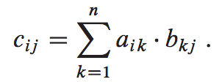
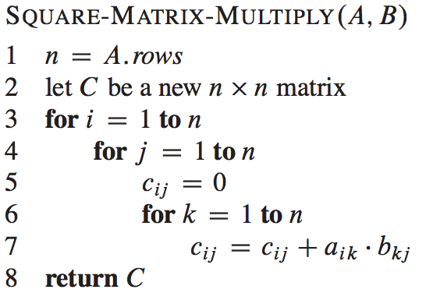
Square matrix multiplication
Square matrix multiplication
  If A = (a_{ij}) and B = (b_{ij}) are square n×n matrices, then in the product C = A × B, we define the entry c_{ij} , for i, j = 1,2,…,n, by
Θ(n³)
Software School of XiDian University

Slide 6
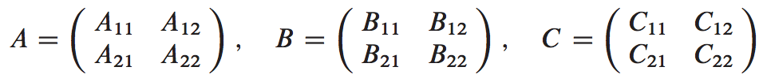

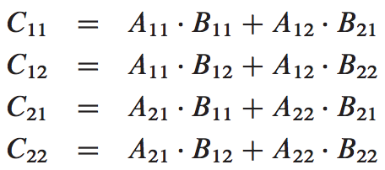
A simple Divide and Conquer algorithm
Assume that n is an exact power of 2 in each of the n×n matrices.
  partition each of A, B, and C into four n/2×n/2 matrices
Software School of XiDian University

Slide 7
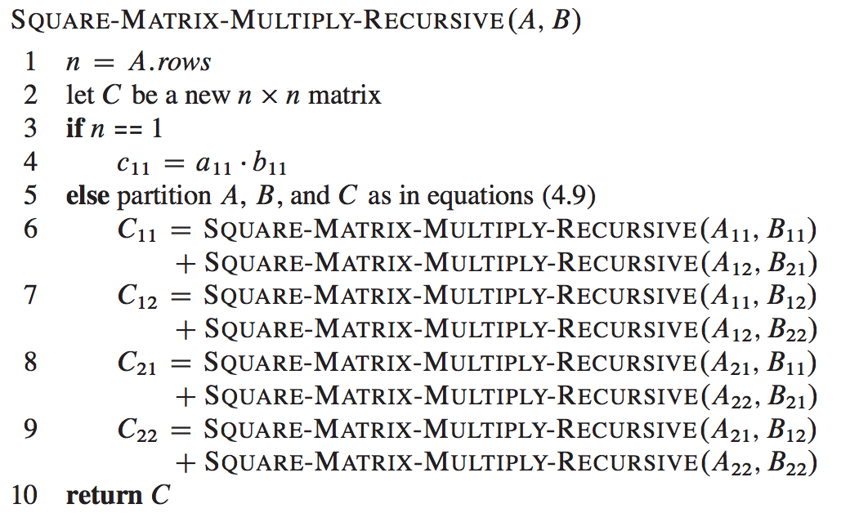
A simple Divide and Conquer algorithm
Software School of XiDian University

Slide 8
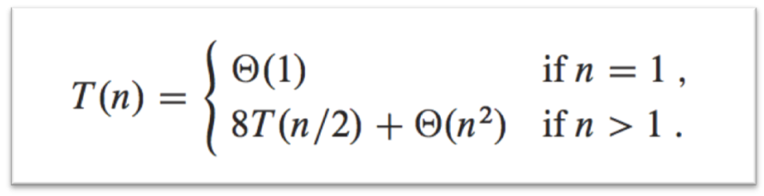
A simple Divide and Conquer algorithm
case1, Θ(n³)
Θ(1)
8T(n/2)
Θ(n²)
Software School of XiDian University
Notes:
第5行常数级时间，可以通过改进算法，使其支持由下标范围标识的子矩阵的运算，而不是真正创建子数组并将元素拷贝出去

Slide 9
Strassen’s method
A improvement of the simple Divide and Conquer algorithm.
  The key is to make the recursion tree slightly less bushy.
  8 recursive multiplications of n/2×n/2 matrices to only 7.
Software School of XiDian University
Notes:
bushy：茂盛

Slide 10
Strassen’s method
  Divide the input matrices A and B and output matrix C into n/2×n/2 submatrices.
  Create 10 matrices S₁,S₂,…,S₁₀ ,each of which is n/2×n/2 and is the sum or difference of two matrices created in step 1.
  Using the submatrices created in step 1 and the 10 matrices created in step 2, recursively compute seven matrix products P₁,P₂,…,P₇ . Each matrix P_{i} is n/2×n/2.
  Compute the desired submatrices C₁₁, C₁₂, C₂₁, C₂₂ of the result matrix C by adding and subtracting various combinations of the P_{i} matrices.
Software School of XiDian University

Slide 11
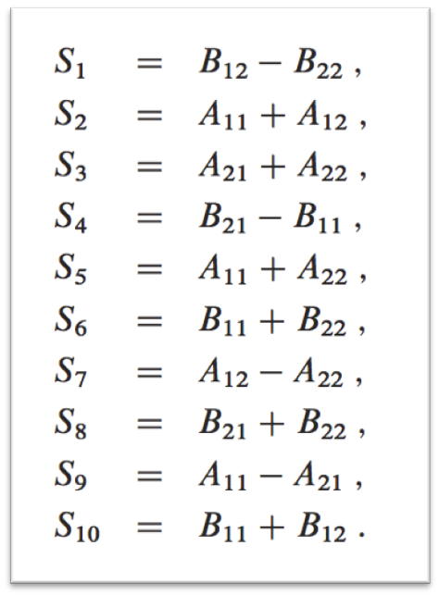
Strassen’s method
  Divide the input matrices A and B and output matrix C into n/2×n/2 submatrices.
  Create 10 matrices S₁,S₂,…,S₁₀ ,each of which is n/2×n/2 and is the sum or difference of two matrices created in step 1.
  Using the submatrices created in step 1 and the 10 matrices created in step 2, recursively compute seven matrix products P₁,P₂,…,P₇ . Each matrix P_{i} is n/2×n/2.
  Compute the desired submatrices C₁₁, C₁₂, C₂₁, C₂₂ of the result matrix C by adding and subtracting various combinations of the P_{i} matrices.
Θ(n²)
Software School of XiDian University

Slide 12
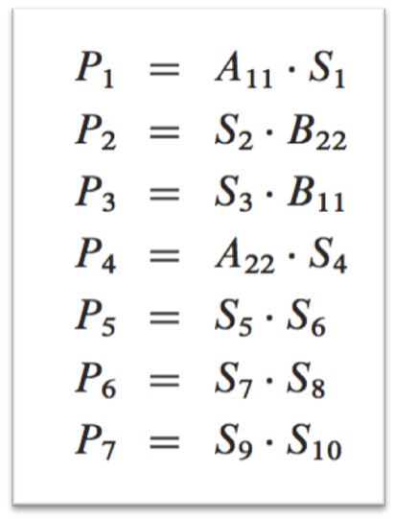
Strassen’s method
  Divide the input matrices A and B and output matrix C into n/2×n/2 submatrices.
  Create 10 matrices S₁,S₂,…,S₁₀ ,each of which is n/2×n/2 and is the sum or difference of two matrices created in step 1.
  Using the submatrices created in step 1 and the 10 matrices created in step 2, recursively compute seven matrix products P₁,P₂,…,P₇ . Each matrix P_{i} is n/2×n/2.
  Compute the desired submatrices C₁₁, C₁₂, C₂₁, C₂₂ of the result matrix C by adding and subtracting various combinations of the P_{i} matrices.
Θ(n²)
7T(n/2)
Software School of XiDian University

Slide 13
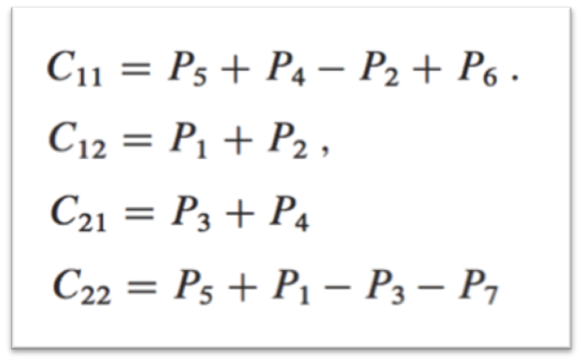
Strassen’s method
  Divide the input matrices A and B and output matrix C into n/2×n/2 submatrices.
  Create 10 matrices S₁,S₂,…,S₁₀ ,each of which is n/2×n/2 and is the sum or difference of two matrices created in step 1.
  Using the submatrices created in step 1 and the 10 matrices created in step 2, recursively compute seven matrix products P₁,P₂,…,P₇ . Each matrix P_{i} is n/2×n/2.
  Compute the desired submatrices C₁₁, C₁₂, C₂₁, C₂₂ of the result matrix C by adding and subtracting various combinations of the P_{i} matrices.
Θ(n²)
7T(n/2)
Θ(n²)
Software School of XiDian University

Slide 14
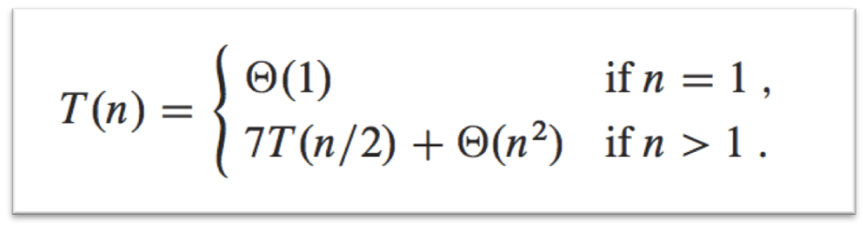
Strassen’s method
case1, Θ(n^{lg7})
  Divide the input matrices A and B and output matrix C into n/2×n/2 submatrices.
  Create 10 matrices S₁,S₂,…,S₁₀ ,each of which is n/2×n/2 and is the sum or difference of two matrices created in step 1.
  Using the submatrices created in step 1 and the 10 matrices created in step 2, recursively compute seven matrix products P₁,P₂,…,P₇ . Each matrix P_{i} is n/2×n/2.
  Compute the desired submatrices C₁₁, C₁₂, C₂₁, C₂₂ of the result matrix C by adding and subtracting various combinations of the P_{i} matrices.
Θ(n²)
7T(n/2)
Θ(n²)
Software School of XiDian University
Notes:
Lg7=2.80~2.81
目前已知的矩阵相乘的最低计算时间可达到O(n^2.376)，Coppersmith and Winograd, 1990
Strassen算法可应用于n非2的幂的情况
Strassen算法实际应用时可能的问题：
（1）常数系数可能比原始n^3算法要大
（2）稀疏矩阵，专用算法更快
（3）存在数值稳定性问题（即浮点数计算的累积误差更大）
（4）递归过程中占用更多辅助存储空间
实际应用时使用Strassen算法的临界规模：
（1）理论上n=8/12时
（2）实际测试400~2150，不同机器测试结果不同

Slide 15
Simple Review
Order Statistics
  Expected linear time selection
    Main idea: PARTITION
    Worst-case Θ(n²)
  Worst-case linear time selection
    Generate a good pivot recursively.
Square Matrix Multiplication
  Simple Divide and Conquer algorithm
    Θ(n³)
  Strassen’s algorithm
    8 recursive multiplications of n/2×n/2 matrices to only 7.
    Θ(n^{lg7})

Slide 16
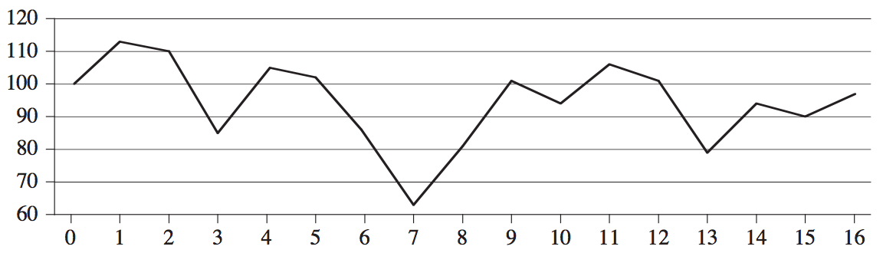
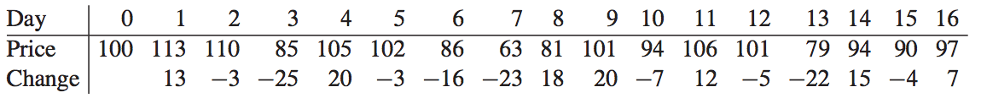
The maximum-subarray problem
Stock Investing Problem
  Suppose that you been offered the opportunity to invest in the Volatile Chemical Corporation. You are allowed to buy one unit of stock only one time and then sell it at a later date, buying and selling after the close of trading for the day. To compensate for this restriction, you are allowed to learn what the price of the stock will be in the future. Your goal is to maximize your profit.
Software School of XiDian University
Notes:
volatile
compensate：为…进行补偿

Slide 17
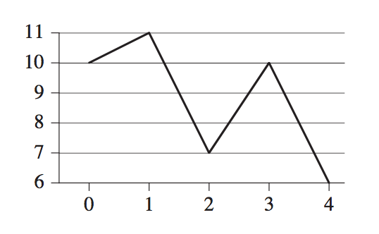
The maximum-subarray problem
Solution？
  By either buying at the lowest price or selling at the highest price？
  Find the highest and lowest prices, and then work left from the highest price to find the lowest prior price, work right from the lowest price to find the highest later price, and take the pair with the greater difference.
Software School of XiDian University

Slide 18
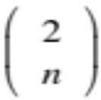
The maximum-subarray problem
A brute-force solution
  Try every possible pair of buy and sell dates in which the buy date precedes the sell date. A period of n days has such pairs of dates. Since is Θ(n²), and the best we can hope for is to evaluate each pair of dates in constant time, this approach would take Ω(n²) time.
Software School of XiDian University

Slide 19
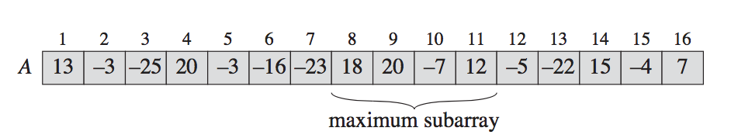
The maximum-subarray problem
Transform to maximum-subarray problem
  We want to find a sequence of days over which the net change from the first day to the last is maximum.
  Instead of looking at the daily prices, let us instead consider the daily change in price, where the change on day i is the difference between the prices after day i-1 and after day i .
Software School of XiDian University

Slide 20
Maximum Subarray-brute-force solution
BRUTE-FORCE-MAXIMUM-SUBARRAY
int BetterMaximumSubarray(int n, int a, int &besti, int &bestj) { int sum = -1; for(int i=1; i <= n; ++i){ int thissum = 0; for(int j=i; j <= n; ++j){ thissum += a[j]; if(thissum > sum){ sum = thissum; besti = i, bestj = j; } } } return sum; }
Θ(n²)

Slide 21
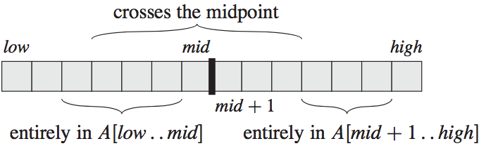
The maximum-subarray problem
Divide and Conquer
  Divide: Divide the array A[low..high] into two subarrays of n/2 elements, A[low..mid] and A[mid+1..high].
  Conquer: Find the maximum subarray recursively.
  Combine: Select a subarray with the largest sum of the sub-problems’.
Software School of XiDian University

Slide 22
The maximum-subarray problem
Sub-problems
  Any contiguous subarray A[i..j] of A[low..high] must lie in exactly one of the following places:
    entirely in the subarray A[low..mid] , so that low ≤ i ≤ j ≤ mid
    entirely in the subarray A[mid+1..high] , so that mid < i ≤ j ≤ high
    or crossing the midpoint, so that low ≤ i ≤ mid < j ≤ high.
recursive
Software School of XiDian University

Slide 23
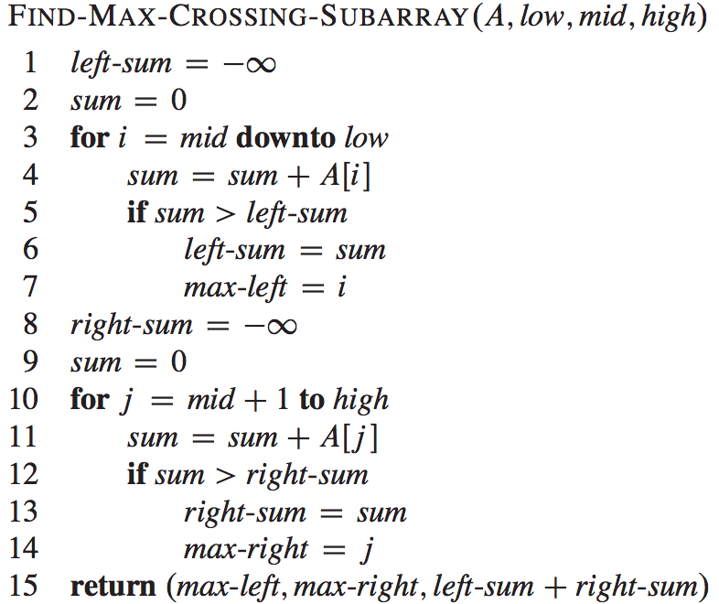
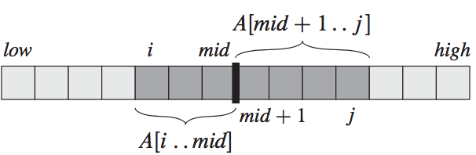
Find Max Crossing Subarray
Θ(n)

Slide 24
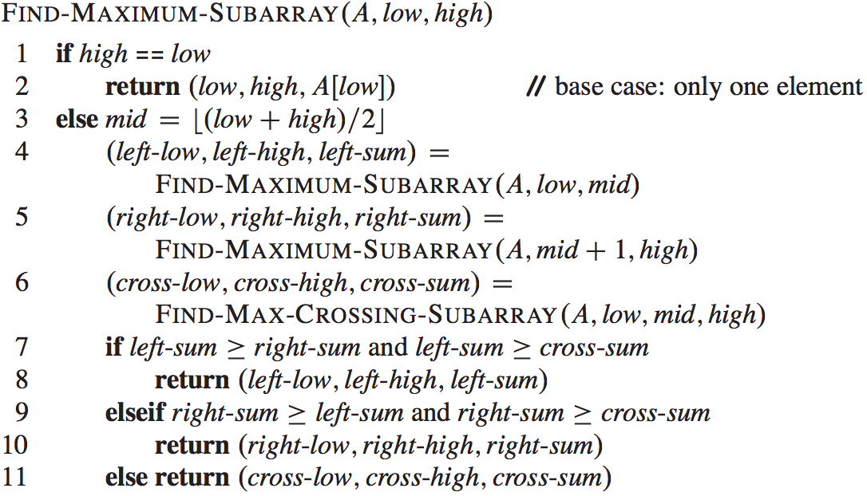
Maximum Subarray-Divide&Conquer

Slide 25
Maximum Subarray-Divide&Conquer
(8,11,43)
(8,11,43)
(4,4,20)
(9,11,25)
(4,5,17)
(9,16,16)
(4,4,20)
(8,8,18)
(9,11,25)
(14,16,18)
(1,4,5)
(6,8,-21)
(9,11,25)
(14,16,18)
(1,1,13)
(4,4,20)
(5,5,-3)
(8,8,18)
(9,9,20)
(11,11,12)
(14,14,15)
(16,16,7)
(1,2,10)
(3,4,-5)
(5,6,-19)
(7,8,-5)
(9,10,13)
(11,12,7)
(13,14,-7)
(15,16,3)
13 | -3 | -25 | 20 | -3 | -16 | -23 | 18 | 20 | -7 | 12 | -5 | -22 | 15 | -4 | 7
1 | 2 | 3 | 4 | 5 | 6 | 7 | 8 | 9 | 10 | 11 | 12 | 13 | 14 | 15 | 16

Slide 26
Maximum Subarray-Divide&Conquer
Θ(nlgn)
Θ(1)
T(n/2)
T(n/2)
Θ(n)
Θ(1)

